Slide 1
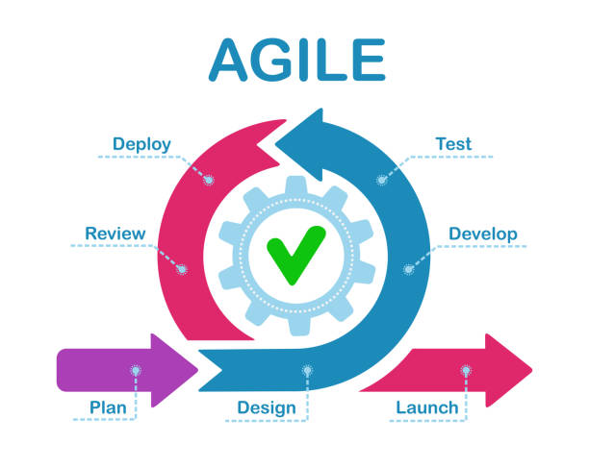
Agile
Plan | Create a basic game plan than business needs addressed with room to change and improve
Design | Create a basic outline of the product that the stakeholder agrees upon
Develop | Create a workable product that can be tested and showed to stakeholder
Test | Test workable software for bugs and quality inspection
Deploy | Show off workable software to customers / stakeholders
Review | Gather input on current iteration of product. Improve where customer wants improvement
Repeat | Repeat steps until product is ready to officially launch
Launch | Product is officially released. Congratulations!!!

Slide 2
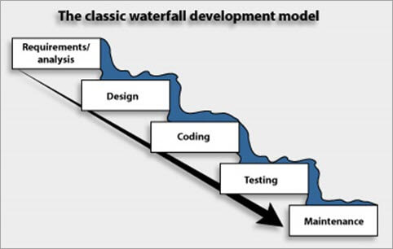
Waterfall
Requirements | Define customer/ stakeholders needs
Design | Create basic layout of the product
Implementation | Develop the product/ software
Verification | Make sure product is good enough for release
Maintenance | Inspect quality of product and fix any bugs.

Slide 3
Waterfall Vs Agile
Waterfall
Agile
Workflow is in one direction like a waterfall. Can not go back to change or fix anything in previous steps. Useful in small projects
without a lot of dependencies.
Not as collaborative with other team members or customer. Usually has specialist/ not much room/time from individual improvement
Plan out basic requirements. Lots of room for change
Customer is part of most processes right until the end.
Requirements can change based on customer’s needs which brings more value to the product.
Each iteration or sprint for the product produces working software if possible.
Process repeats until no longer necessary. Redesign is easier without scrapping old work.

Slide 4
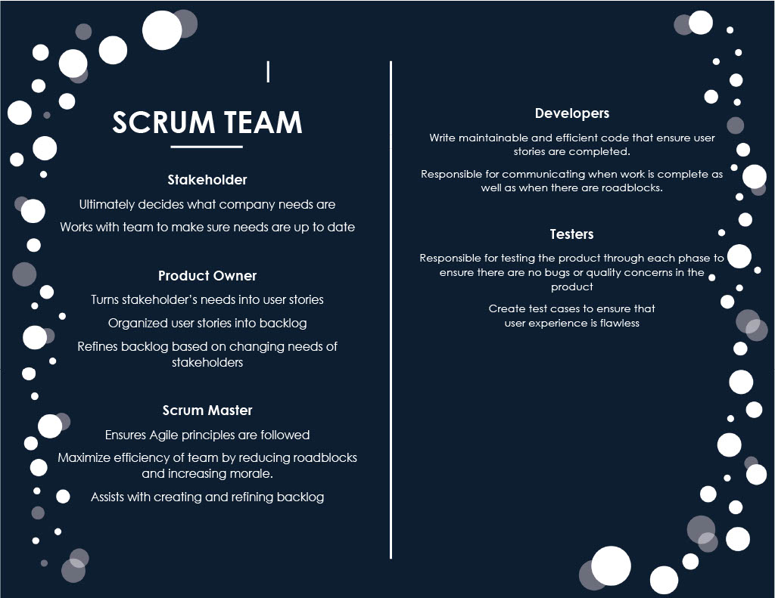

Slide 5
Citations
Waterfall graphic sourced from Monday.com
Agile graphic sourced from istock.com
I do not own rights to images and they are used for educational purposes only.
Information pertaining to Agile or Waterfall methodologies are sourced from SNHU learning materials.
There are no direct quotes from sources but may be similarities.

